Slide 1
PERFORMANCE ENHANCEMENT
A bottom-up optimization approach

Slide 2
5W Principal
What is it?
Why to use?
How to use?
When should use?
When shouldn’t use?

Slide 3
OUTLINE
Part 1: Java Optimization
Part 2: Multithreading
Part 3: JVM Optimization
Part 4: Machine Optimization
Part 5: Duplicate Performance

Slide 4
Java Optimization
Give the best practices to improve Java performance and code quality

Slide 5
Outline
Object Instantiation
Mutable vs Immutable
HashMap
Final keyword
Enum
Exception Handling (TBD)

Slide 6
Object Instantiation
int x1;
int x2 = 1;
Integer x3 = 1;
Integer x4 = new Integer(1);
Integer y1 = new Integer(x2);
Integer y2 = x2 + x2 - 1;
Integer y3 = new Integer(x3 + 1) - 1;
Integer x = 128, y = 128;
(x1 == x2); (x1.equals(x2));
(x2 == x3); (x2.equals(x3));
(x3 == x4); (x3.equals(x4));
(y1 == x4); (y1.equals(x4));
(y1 == x2); (y1.equals(x2));
(y2 == x2); (y2.equals(x2));
(y2 == x3); (y2.equals(x3));
(y3 == x3); (y3.equals(x3));
(y3 == x2); (y3.equals(x2));
(x == y); (x.equals(y));
Notes:
(x1 == x2); // compile error | (x1.equals(x2)); // compile error
(x2 == x3); // true | (x2.equals(x3)); // compile error
(x3 == x4); // false | (x3.equals(x4)); // true
(y1 == x4); // false | (y1.equals(x4)); // true
(y1 == x2); // true | (y1.equals(x2)); // true
(y2 == x2); // true | (y2.equals(x2)); // true
(y2 == x3); // true | (y2.equals(x3)); // true
(y3 == x3); // true | (y3.equals(x3)); // true
(y3 == x2); // true | (y3.equals(x2)); // true
(x == y); // false | (x.equals(y)); // true

Slide 7
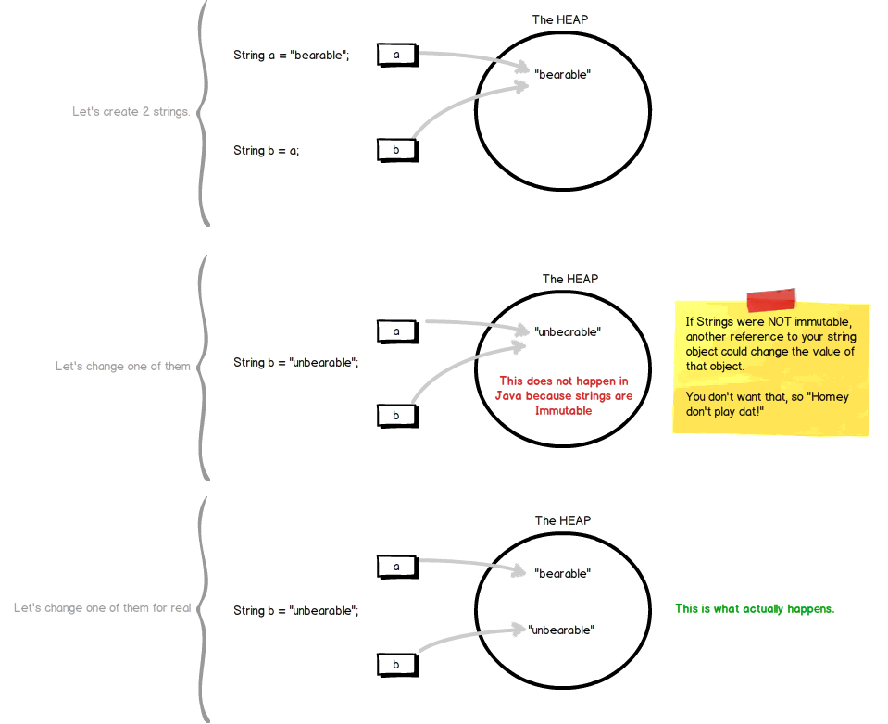
String Immutable?

Slide 8
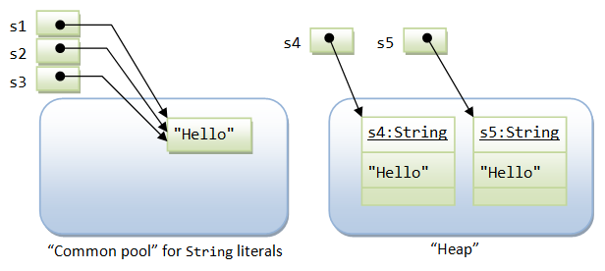
String: Literal vs. Object
String s1 = "Hello"; // String literal
String s2 = "Hello"; // String literal
String s3 = s1; // same reference
String s4 = new String("Hello"); //String Object
String s5 = new String("Hello"); // String object

Slide 9
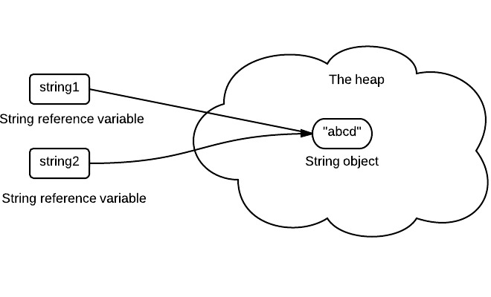
String Pool
String string1 = "abcd";
String string2 = "abcd";
String pool (String intern pool) is a special storage area in Java heap. When a string is created and if the string already exists in the pool, the reference of the existing string will be returned, instead of creating a new object and returning its reference.

Slide 10
Mutable vs Immutable
public class Employee {
public long id;
public String name;
private Date birthday
public Employee(long id, String name, Date birthday) {
this.id = id;
this.name = name;
this.birthday = birthday;
}
public String getName() {
return name;
}
public void setName(String name) {
this.name = name;
}
public Date getBirthday() {
return birthday;
}
public void setBirthday(Date birthday) {
this.birthday = birthday;
}
}
Make Employee to be Immutable
Notes:
public final class Employee {
private final long id;
private final String name;
private final Date birthday;
private int hash;
public Employee(long id, String name, Date birthday) {
this.id = id;
this.name = name;
this.birthday = birthday;
}
public long getId() {
return id;
}
public String getName() {
return name;
}
public Date getBirthday() {
return new Date(birthday.getTime());
}
/**
* Lazy Initialization
*/
@Override
public int hashCode() {
if (hash == 0) {
final int prime = 31;
int result = 1;
result = prime * result + ((birthday == null) ? 0 : birthday.hashCode());
result = prime * result + (int) (id ^ (id >>> 32));
result = prime * result + ((name == null) ? 0 : name.hashCode());
hash = result;
}
return hash;
}
}

Slide 11
HashMap
HashMap grades
HashMap<String, String> grades = new HashMap<>();
grades.put("Martin", "A");
grades.put("Nelson", "F");
grades.put("Milhouse", "B");
// What grade did they get?
System.out.println(grades.get("Nelson"));
System.out.println(grades.get("Martin"));
grades.put("Nelson", "W");
grades.remove("Martin");
System.out.println(grades.get("Nelson"));
System.out.println(grades.get("Martin"));
HashMapEntry
HashMap
"Martin"
"A"
0
HashMapEntry
2
"Nelson"
"F"
HashMapEntry
5
"Milhouse"
"B"

Slide 12
HashMap
public class Student {
private String sid;
private String name;
public String getSid() {
return sid;
}
public void setSid(String sid) {
this.sid = sid;
}
public String getName() {
return name;
}
public void setName(String name) {
this.name = name;
}
}
public class Teacher {
private String tid;
private String name;
public String getTid() {
return tid;
}
public void setTid(String tid) {
this.tid = tid;
}
public String getName() {
return name;
}
public void setName(String name) {
this.name = name;
}
}

Slide 13
HashMap
Map<Teacher, Student> map = new HashMap<>();
Teacher t1 = new Teacher("V", "Vinh");
Teacher t2 = new Teacher("T", "Trung");
Teacher t3 = new Teacher("V", "Vinh");
Teacher t4 = t1;
Student s1 = new Student("P", "Phuong");
Student s2 = s1;
map.put(t1, s1);
map.put(t2, s1);
map.put(t1, s1);
map.put(t1, s2);
map.put(t3, s1);
map.put(t4, s2);
With hashcode & equals?

Slide 14
Final Keyword
public final String concat(final String a, final String b) {
return a + b;
}
Helpful?

Slide 15
Multithreading
Give comparisons between single-thread and multi-thread environment

Slide 16
Outline
Thread Safe: synchronization, volatile
Fail-safe vs Fail-Fast
Concurrency Collection
Multi-task processing
Synchronization - Deadlock
Asynchronous Processing Model: MQ
Non-blocking

Slide 17
Thread-Safe?
class MyCounter {
private static int counter = 0;
public static int increase() {
return counter++;
}
}
Notes:
counter++ operation is not atomic, one is accessing value and the other is increasing the value by one.

Slide 18
Thread-Safe Object
synchronized.
Atomic Wrapper classes (java.util.concurrent.atomic). Exp: AtomicInteger
Lock (java.util.concurrent.locks).
Thread safe collection classes.
volatile keyword (how about volatile + final).
Immutable is completely Thread-Safe

Slide 19
Fail-Safe vs Fail-Fast
List<Integer> list = new ArrayList<Integer>();
for (int i = 0; i < 10; i++) {
list.add(i);
}
for (Integer i : list) {
if (i == 3)
list.remove(i);
}

Slide 20
Fail-Safe vs Fail-Fast
 | Fail Fast Iterator | Fail Safe Iterator
Throw ConcurrentModification Exception | Yes | No
Clone object | No | Yes
Memory Overhead | No | Yes
Examples | HashMap,Vector,ArrayList,HashSet | CopyOnWriteArrayList, ConcurrentHashMap

Slide 21
Concurrency Collection
ConcurrentHashMap
CopyOnWriteArrayList and CopyOnWriteArraySet
BlockingQueue
Deque and BlockingDeque
ConcurrentSkipListMap and ConcurrentSkipListSet
WHEN SHOULD NOT USE?

Slide 22
Multi-task Processing
Runtime.getRuntime().availableProcessors()
Processors – Thread – Core – CPU?

Slide 23
Synchronization - Deadlock
public class Deadlock {
static class Friend {
private final String name;
public Friend(String name) {
this.name = name;
}
public String getName() {
return this.name;
}
public synchronized void bow(Friend bower) {
System.out.format("%s: %s" + " has bowed to me!%n", this.name, bower.getName());
bower.bowBack(this);
}
public synchronized void bowBack(Friend bower) {
System.out.format("%s: %s" + " has bowed back to me!%n", this.name, bower.getName());
}
}
public static void main(String[] args) {
final Friend alphonse = new Friend("Alphonse");
final Friend gaston = new Friend("Gaston");
new Thread(new Runnable() {
public void run() {
alphonse.bow(gaston);
}
}).start();
new Thread(new Runnable() {
public void run() {
gaston.bow(alphonse);
}
}).start();
}
}

Slide 24
Asynchronous Processing Model
Service A
1000 TPS
Service B
500 TPS
Service A1
1000 TPS
Service B
2000 TPS
Service A2
1000 TPS

Slide 25
Non-blocking
Client
Ingest Service
Worker Manager
WORKER 2
WORKER 1
WORKER 3
Engest Service
DATABASE

Slide 26
JVM Optimization
Optimize JVM configuration for different purpose

Slide 27
Outline
JVM Memory
JVM Monitoring
Garbage Collection

Slide 28
JVM Memory
The JVM divided the memory into following sections.
Heap: contains Objects (may also contain reference variables).
Stack: contains methods, local variables and reference variables.
Code: contains your bytecode
Static: contains Static data/methods.
This division of memory is required for its effective management.

Slide 29
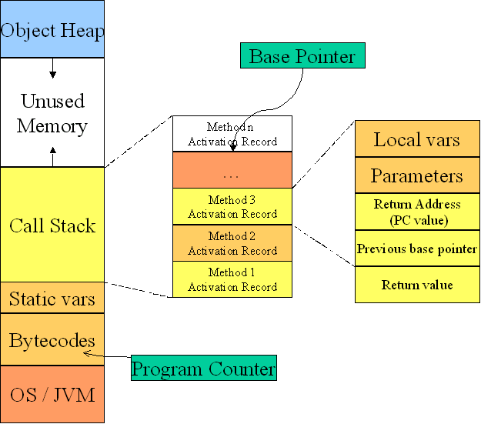
JVM Memory

Slide 30
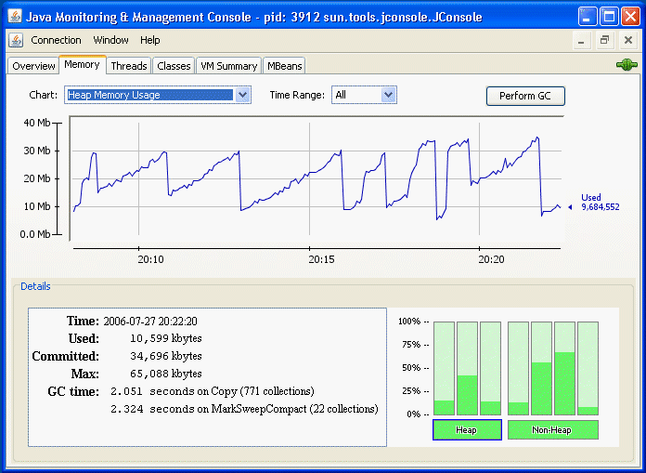
JVM Monitoring: JConsole

Slide 31
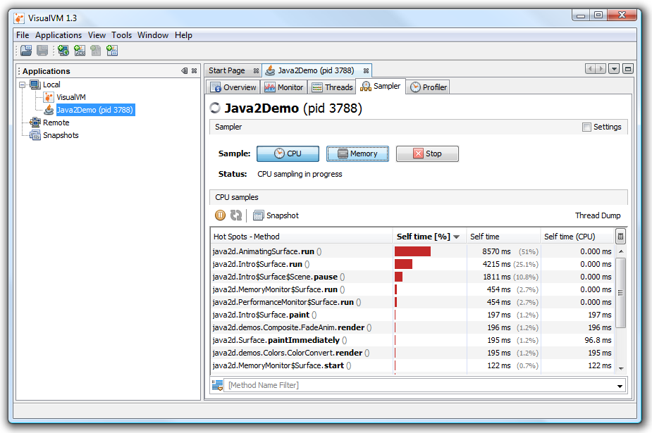
JVM Monitoring: VisualVM

Slide 32
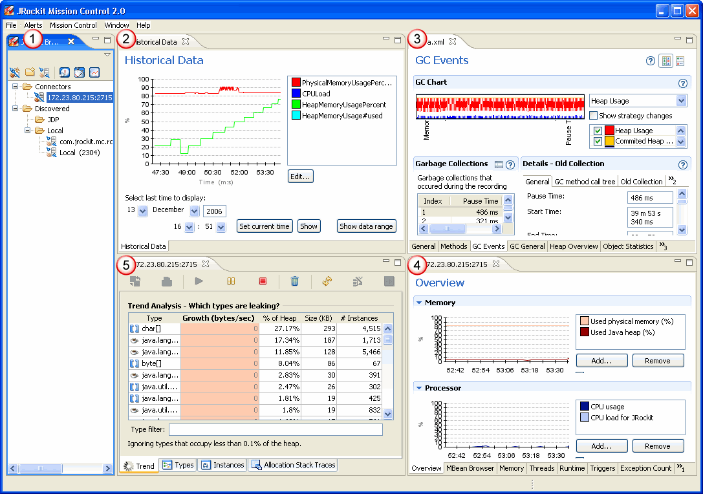
JVM Monitoring: JRockit

Slide 33
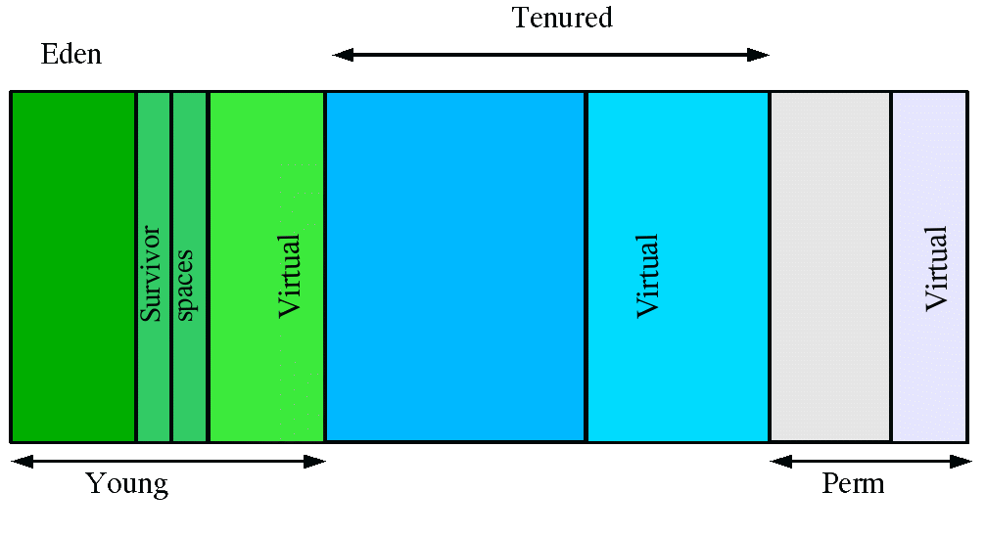
Garbage Collection

Slide 34
Machine Optimization
Optimize Hardware infrastructure

Slide 35
Outline
Processor: CPU
Storage: HDD, SDD
Network Bandwidth
TCP Connection

Slide 36
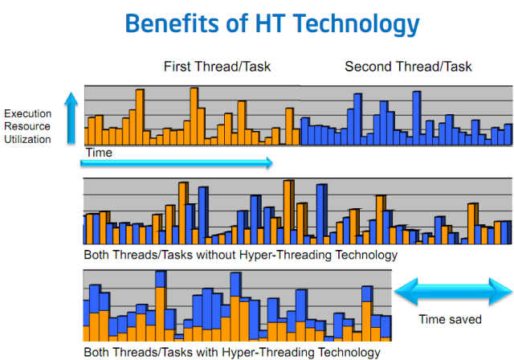
Processor: CPU

Slide 37
Storage
HDD: 7200RPM, 10000PRM.
SSD.
RAID.
SAN.

Slide 38
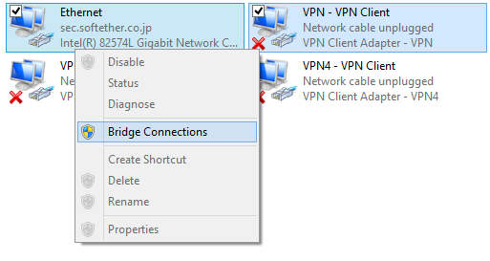
Network Bandwidth

Slide 39
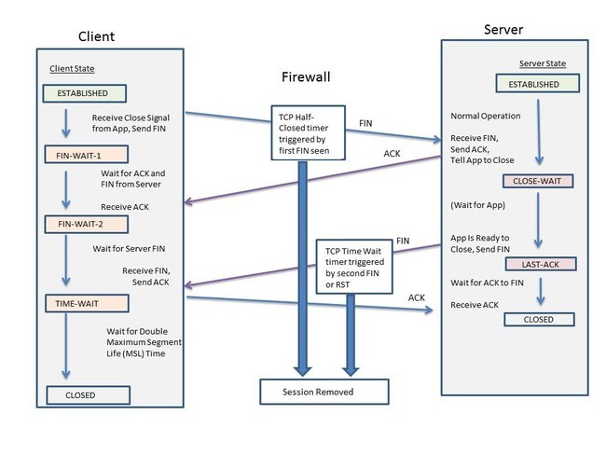
TCP Connection
Change this default config only for a very special requirement

Slide 40
Duplicate Performance
When upgrading hardware doesn’t help or not feasible

Slide 41
Outline
Clustering
Application Load Balancing
DNS Load Balancing

Slide 42
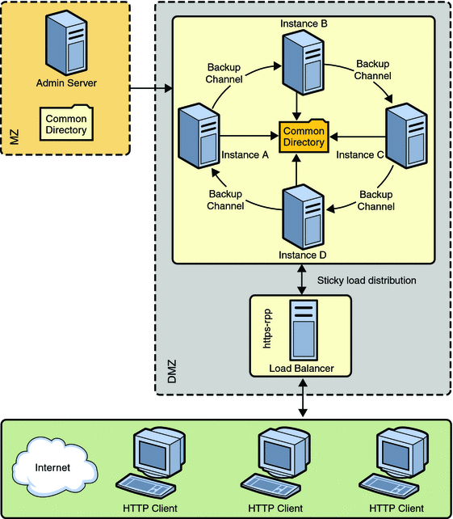
Clustering

Slide 43
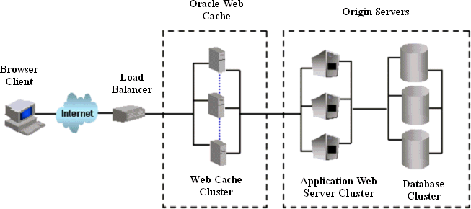
Application Load Balancing

Slide 44
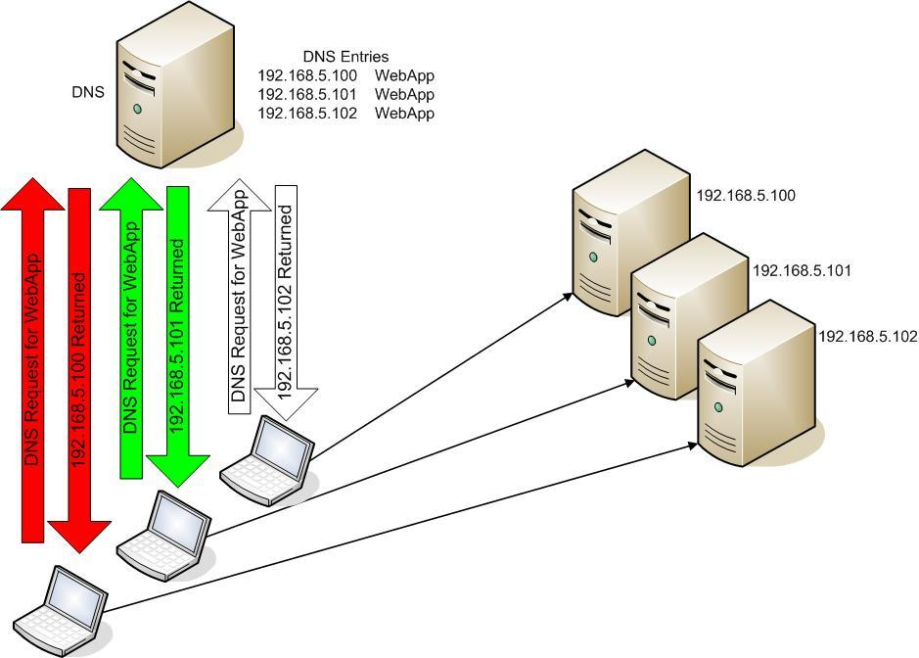
DNS Load Balancing

Slide 45
Example
Client Browser
1
FRONTEND APPLICATION SERVER
5
APP INSTANCE 1
6
CENTRAL DATABASE
LOAD BALANCER
8
9
APP INSTANCE 2
4
10
APP INSTANCE 3
11
2
3
DNS ROUND ROBIN
abc.com: x.x.x.x
abc.com: y.y.y.y
aac.com: z.z.z.z
Flow Description:
1: Browser connect to frontend application located in a separated server.
2: Browser need to connect to API at: abc.com/api. PC send DNS query to ask for IP address
3: DNS Round Robin return different IP address for each query.
4: Browser connect to given IP address which connect to a Load Balancer.
5: Load Balancer distributes request to a running App Instance.
6: App Instance 1 hit database to read or write.

Slide 46
Q&A

